Slide 1
How To Make Achievement Gains Using Innovative Practices and Programs
Kristi Jenkins, NBCT
Gear Up Academic Specialist
Somerset High

Slide 2
Holy Benchmark, Batman!
How do we get these ACT scores up?

Slide 3
What does the data tell us?

Slide 4
State Ranking:
We ranked seventh in composite score improvement in the state, according to Torchprep.

Slide 9
Magic or Madness?

Slide 10
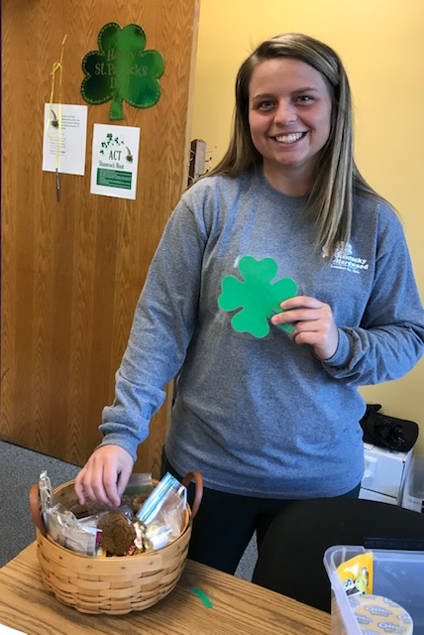
Practice for the ACT without practicing for the ACT.

Slide 11
Find ways to include everyone in ACT reviews that are fun.

Slide 12
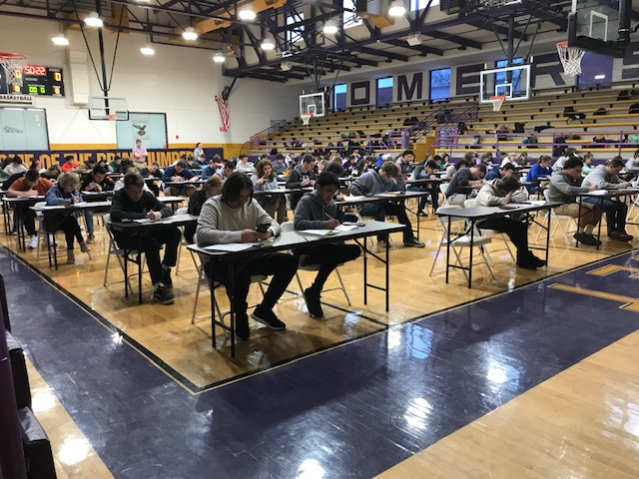
Do you scrimmage? We do. It works.

Slide 13
Get everyone –
and I mean everyone – on board!
There are four reading passages. Only one is a literary passage.
The others are:
A&H
Natural Science
Social Science
Do my teachers know that?

Slide 14
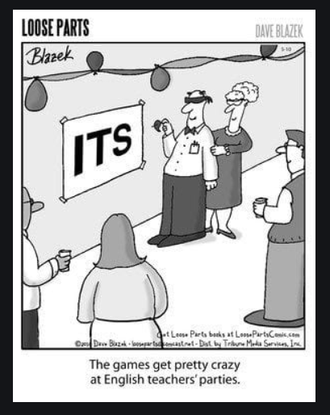
Are you still making the reading test the responsibility of the English teachers?

Slide 15
Eighty percent of students do not finish the reading section in the allotted time.

Slide 16
15 minutes seems to be the “magic num15 minutes seems to be the “magic number” at which students start seeing substantial positive gains in reading achievement; students who read just over a half-hour to an hour per day see the greatest gains of all.ber” at which students start seeing substantial positive gains in reading achievement; students who read just over a half-hour to an hour per day see the greatest gains of all.
Renaissance.com(2018)

Slide 17
Eight minutes a day. EIGHT.
One passage and 10 questions should take 8 minutes.

Slide 18
Gear Up brought the Blitz to our students free of charge.

Slide 19
Tutoring:
What works.
What doesn’t.

Slide 20
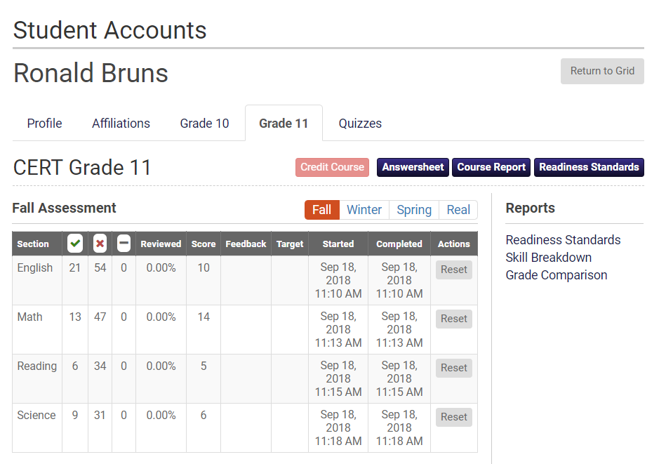
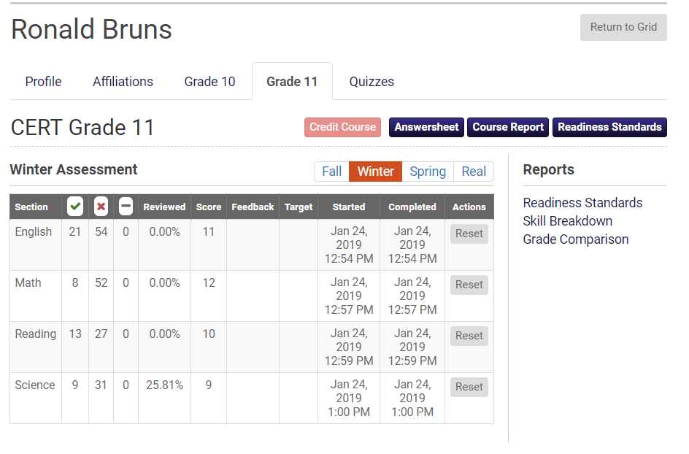

Slide 21
Give this student what she needs!

Slide 22
Create Conversation!
ACT!

Slide 23
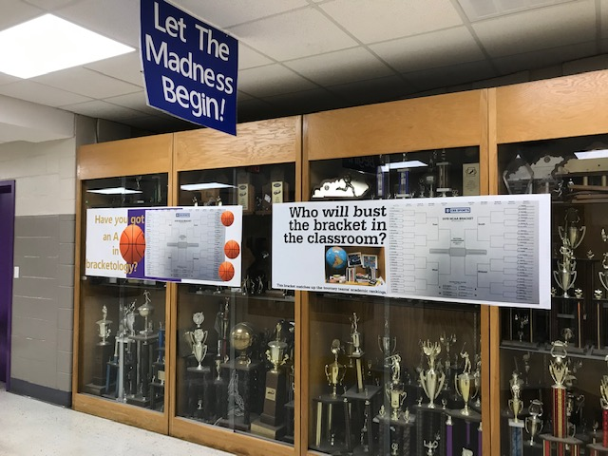
ACT!

Slide 24
What is test day like?
Make it an event!
What will work in your school, in your community, and with your kids?
Some things to think about…
A Pep Rally for the ACT
A special breakfast for everyone on ACT day
A special lunch for everyone after the test
A countdown to test day
T-shirts for all test takers
Whatever you do, it needs to feel like a big deal.

Slide 25
Can you improve your testing environment?
Who are your proctors?
What is the vibe in your testing area(s)?
Is it suited for success?
What does testing day
at SHS look like?

Slide 26
That’s great, but you want to talk about the sweet new turf.

Slide 27
