Slide 1
Kentucky Association of School Councils: Assessment and Accountability Update
Office of Standards, Assessment and Accountability
Jennifer Stafford, Director
Michael Hackworth, Policy Advisor

Slide 2
Agenda
2018-2019 Accountability
Kentucky’s Accountability Standards Setting
School Report Card Prototypes
Quality of School Climate and Safety
Transition to New Assessments

Slide 3
2018-2019 Accountability

Slide 4
2018-2019 Reporting
Schools, Districts, and State WILL receive:
Star Ratings (1 to 5 stars)
Overall Accountability Score
Indicator scores and labels of very high to very low for Proficiency, Growth (EL/MS), Separate Academic (EL/MS/HS), Transition Readiness (HS), and Graduation (HS)
Federal Classifications

Slide 5
Overall Accountability Rating
Each school will be assigned an Overall Rating of one to five stars, based on the overall score of combined school-level measures and indicators of Proficiency, Separate Academic, Growth, Transition Readiness, and Graduation Rate using the weights approved by KY Board of Education.
Quality of School Climate and Safety coming in 2019-2020.

Slide 6
Accountability for 2018-2019
Elementary/Middle (5-star, CSI/TSI)
Proficiency
Reading and Mathematics
Separate Academic
Science, Social Studies and Writing
Growth
Reading and Mathematics
Proficiency/English Attainment (English Learners only)
High School (5-star, CSI/TSI)
Proficiency
ACT – Reading and Mathematics scores
Separate Academic
Science and Writing
Graduation Indicator
4 and 5 year rate used for CSI I
4 year graduation rate used for CSI II (below 80%)
Transition Readiness
ACT, College Placement Exams, Dual Credit, AP, IB, Ind. Cert, CTE EOP (tied to articulated credit), Apprenticeship will be included, Exceptional Work Experience, ACCESS for ELLs

Slide 7
Indicators – Elementary and Middle Schools
Indicator | Measures | Metric (Elementary and Middle Schools)
Proficiency | Reading and mathematics tests | Index Score (0-125) N=0, A=.50, P=1.0, D=1.25 Each score from reading and mathematics weighted equally
Separate Academic | Science, social studies and writing tests | Index Score (0-125) N=0, A=.50, P=1.0, D=1.25 Each score from science, social studies and writing weighted equally
Growth | Reading and mathematics tests, English Language Profi-ciency (ELP) tests | Growth Score (0 - 300) Value table that assigns points for individual student growth Each score from reading (including ELP) and mathematics weighted equally

Slide 8
 | High | Schools
Indicator | Measures | Metric
Proficiency | Reading and mathematics sections from ACT (weighted equally) | Index Score (0-125) N=0, A=.50, P=1.0, D=1.25 (ACT levels)
Separate Academic | Science and writing tests (weighted equally) | Index Score (0-125) N=0, A=.50, P=1.0, D=1.25
Transition Readiness | Academic Readiness, (ACT, College Placement, Dual Credit, AP, IB, CAI, ELP) Career Readiness (Ind. Cert., CTE EOP exam, Exceptional Work Experience, Apprenticeship) ELP attainment (ACCESS) | Transition Readiness Rate (0-100) Percentage of graduates who have a high school diploma and also demonstrate Academic or Career Readiness ELs anytime throughout high school
Graduation | 4- and 5-year Graduation Rates | Percentage of grade 9 students (adjusted) who graduated in 4 or 5 years Average of 4- and 5-year rates (0-100)

Slide 9
Overall Accountability Weights
 | Proficiency (Reading and Mathematics) | Separate Academic (Science, Social Studies and Writing) | Growth (including English Language Learners) | Quality of School Climate and Safety | Transition Readiness (including English language) learners) | Graduation (4 and 5 year cohort)
Elementary/ Middle Schools | 35 | 26 | 35 | 4 | -- | --
High Schools | 45 | 15 | -- | 4 | 30 | 6

Slide 10
Kentucky’s Accountability Standard Setting

Slide 11
Accountability Standard Setting
An Accountability Standard Setting was held August 23 and September 4th-5th to determine cut scores for 5 Star Rating and indicator rating for very low to very high
Kentucky is required to identify schools for Comprehensive Support and Improvement (CSI) and Targeted Support and Improvement (TSI) for support (based on 2018-2019 data)
At least 5% of Title I schools must be identified for CSI

Slide 12
Participants of Standard Setting
Representative leaders from across the state
Members of the Accountability | Performance Standard Setting Committee
Hal Heiner, chair, Kentucky Board of Education Gary Houchens, member, Kentucky Board of Education Danny Adkins, superintendent, Floyd County schools Paul Mullins, superintendent, Logan County schools Marty Pollio, superintendent/Dena Dosett, chief executive director, Jefferson County schools Diane Hatchett, superintendent, Berea Independent schools Scott Hawkins, superintendent, Woodford County schools Aaron Collins, superintendent, Fulton County schools Teresa Nicholas, district assessment coordinator, Pulaski County schools Amanda Reed, district assessment coordinator, LaRue County schools Stephen Flatt, director of special education, Marshall County schools Jerri Rowland, principal, Monroe County Area Technology Center | Susan Brashear, principal, Whitley Central Intermediate School Amy Lingo, dean, College of Education, University of Louisville Amy Razor, executive director, Northern Kentucky Cooperative for Educational Services Rhonda Caldwell, executive director, Kentucky Association of School Administrators Rhonda Caldwell/Owen Saylor, Kentucky Association of School Administrators Melissa Aguilar, executive director, Kentucky Workforce Innovation Board Rhonda Harmon, executive director, KASC Annissa Franklin, chief administrative officer, Urban League of Lexington Sarah Davasher-Wisdom, chief operating officer, Greater Louisville Inc. Penny Christian, parent, member of Kentucky PTA Margo Bruce, teacher, Webster County High School Amanda Underwood, teacher, Mason County Middle School

Slide 13
Standard Setting
At its August 2019 meeting, the KBE approved the Kentucky Department of Education’s (KDE) proposal for establishing performance thresholds
A standard setting committee would use a formal standard setting to generate recommendations for the Commissioner
The Commissioner of Education accepted the threshold cut scores recommended by the committee without changes

Slide 14
Standards Setting Process
Systematic process facilitated by the Center for Assessment
Engaged participants individually, in small group and whole group discussions
Began with school and indicator performance level descriptors

Slide 15
Approaches to Standard Setting
Normative Referenced
Criterion Referenced
Deliberate percentage of schools rated at different levels
No specified performance on each indicator (proficiency, separate academic, growth, etc.)
For example, 10% 5-star; 15% 4-star; 50% 3-star, etc.
No specific percentage of schools at each rating level
Performance on indicators had to meet specified criteria
For example, indicators had to be very high, high or medium (growth) to be considered 5-star

Slide 16
Steps of Standard Setting
Determine performance level descriptors (PLD)
Indicator level descriptors
School level descriptors
Set very high to very low on each indicator
Elementary, middle and high
Using 2018-2019 data
Through a spreadsheet form, each participant selected cut scores on each indicator for very high, high, medium, low and very low
Set 1 to 5- star levels
Using established criteria (PLDs, very low to very high)
Through a different spreadsheet form, each participant selected how samples of 40 schools that represented the range of school performance would rate from 1 to 5 stars

Slide 17
Considerations by Panelists
Purpose of the star rating
Mode of communication
Begins conversations on what is working well or needs improvement
NOT a summative assessment or judgement
Does not reflect the entirety of a complex education system
Overall impact of the cut scores
What is good enough
Indicator performance and school performance

Slide 18
Targeted Support and Improvement (TSI)
A school is identified for targeted support and improvement if it has at least one (1) subgroup whose performance in the state accountability system by level is at or below that of all students in any of the lowest-performing five percent (5%) of all schools for three (3) consecutive years and the school is in the lowest-performing ten percent (10%) of all schools by level.
Schools in TSI are identified annually.

Slide 19
Additional Targeted Support and Improvement (ATSI)
A school is identified as additional targeted support and improvement if the school has at least one (1) subgroup whose performance in the state accountability system by level is at or below the summative performance of all students in any of the lowest-performing five percent (5%) of all schools identified and has been identified for targeted support and improvement.
Schools in ATSI are identified every three (3) years.
Identified in fall of 2020 with supports for 2020-21.

Slide 20
Comprehensive Support and Improvement (CSI)
CSI I: Bottom 5% of Title I or non-Title I schools (by level – elementary, middle or high school, beginning 2018-2019);
OR
CSI II: Less than 80% graduation rate for Title I or non-Title I high schools (beginning 2018-2019);
OR
CSI III: Title I or non-Title I schools previously identified for Additional Targeted Support for at least 3 years and have not exited (first year for eligibility in 2023-2024).

Slide 21
School Report Card Prototypes

Slide 22
School Report Card (SRC)
KDE is working with BrightBytes to present accountability in the SRC.
Accountability data may initially be released in a press release and spreadsheets, similar to reporting last fall.

Slide 23
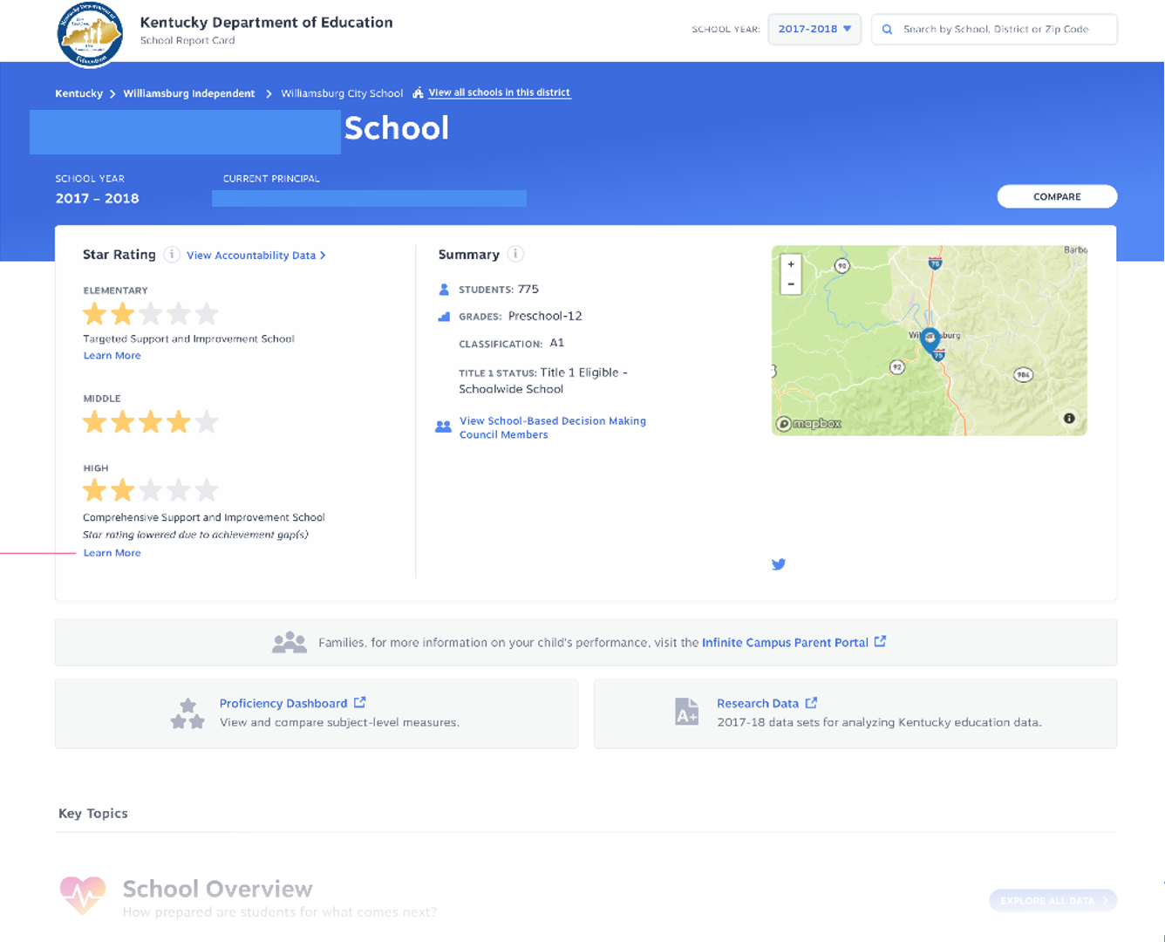

Slide 24
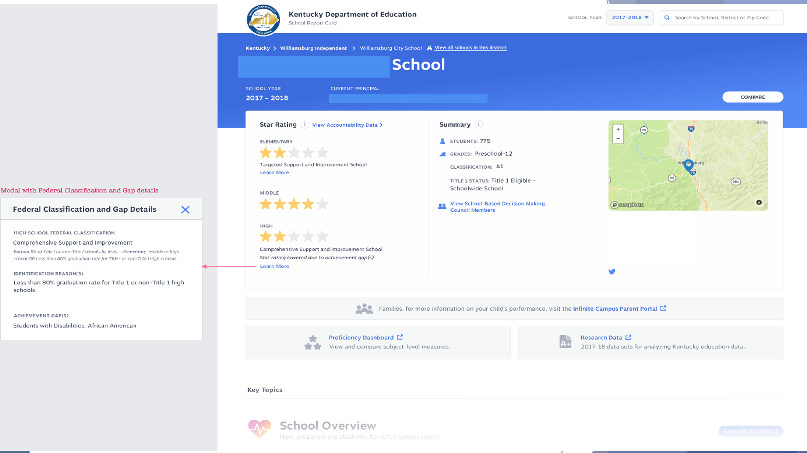

Slide 25
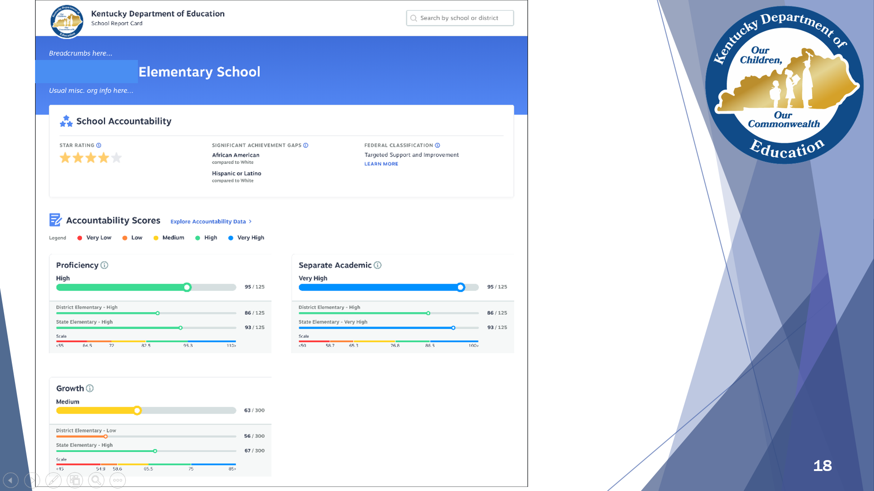

Slide 26
Quality of School Climate and Safety

Slide 27
Background for Inclusion in School Accountability
Requirement in the Every Student Succeeds Act (ESSA) for non-academic indicator
Requirement from KRS 158.6455 to include an indicator of Quality of School Climate and Safety based on perception data from surveys
Delayed by KBE for inclusion in school accountability until 2019-2020 (at 4% weight)
In August 2019, KBE will provide guidance on measures

Slide 28
Definition
School climate reflects how members of the school community experience the school, including interpersonal relationships, teacher and other staff practices, and organizational arrangements. School climate includes factors that serve as conditions for learning and that support physical and emotional safety, connection and support, and engagement
(as defined by the US Department of Education’s National Center on Safe and Supportive Learning Environments)

Slide 29
Purpose
Provide information to educational and community leaders
Using this additional piece of data, may lead to higher academic achievement
Offers direction for school improvement

Slide 30
Transition to New Assessments

Slide 31
Summative Assessment Schedule (Elementary/Middle)
Content | 2018-2019 | 2019-2020 | 2020-2021 | 2021-2022
Reading (3-8) | Current Reading Standards Assessment | Previous Reading Standards Assessment | New Reading Standards Assessment | New Reading Standards Assessment
 |  | New Reading Standards Field Test
Mathematics (3-8) | Current Mathematics Standards Assessment | Previous Mathematics Standards Assessment | New Mathematics Standards Assessment | New Mathematics Standards Assessment
 |  | New Mathematics Standards Field Test
Science (4, 7) | Current Science Standards Assessment | Current Science Standards Assessment | Current Science Standards Assessment | Current Science Standards Assessment
 |  | Current PBT to Online Comparability Study |  | New Science Standards Field Test
On-demand Writing (5, 8) | Current Writing Standards Assessment | Previous Writing Standards Assessment | New Writing Standards Assessment | New Writing Standards Assessment
 |  | New Writing Standards Field Test
Editing & Mechanics (5, 8) | Not Tested | New Writing Standards Field Test | New Writing Standards Assessment | New Writing Standards Assessment
Social Studies (5, 8) | Current Social Studies Standards Assessment | Previous Social Studies Standards Assessment | New Social Studies Standards Assessment | New Social Studies Standards Assessment
 |  | New Social Studies Standards Field Test
TENTATIVE
Current = Current or Previous Kentucky Academic Standards (bold font)
New = New Kentucky Academic Standards (regular font)
Paper and Pencil Administration
Online Administration
Kentucky is in the process of transitioning assessments from paper-based testing (PBT) to online administrations.

Slide 32
Summative Assessment Schedule (High School)
Content | 2018-2019 | 2019-2020 | 2020-2021 | 2021-2022
Reading (10) | Current Reading Standards Field Test | Previous Reading Standards Assessment | New Reading Standards Assessment | New Reading Standards Assessment
 |  | New Reading Standards Field Test
Mathematics (10) | Current Mathematics Standards Field Test | Previous Mathematics Standards Assessment | New Mathematics Standards Assessment | New Mathematics Standards Assessment
 |  | New Mathematics Standards Field Test
Science (11) | Current Science Standards Assessment | Current Science Standards Assessment | Current Science Standards Assessment | Current Science Standards Assessment
 |  |  |  | New Science Standards Field Test
On-demand Writing (11) | Current Writing Standards Assessment | Previous Writing Standards Assessment | New Writing Standards Assessment | New Writing Standards Assessment
 |  | New Writing Standards Field Test
Editing & Mechanics (11) | Not Tested | New Writing Standards Field Test | New Writing Standards Assessment | New Writing Standards Assessment
Social Studies (11) | Not Tested | New Social Studies Standards Field Test | New Social Studies Standards Assessment | New Social Studies Standards Assessment
TENTATIVE
Current = Current or Previous Kentucky Academic Standards (bold font)
New = New Kentucky Academic Standards (regular font)
Paper and Pencil Administration
Online Administration
Kentucky is in the process of transitioning assessments from paper-based testing (PBT) to online administrations.

